Slide 1
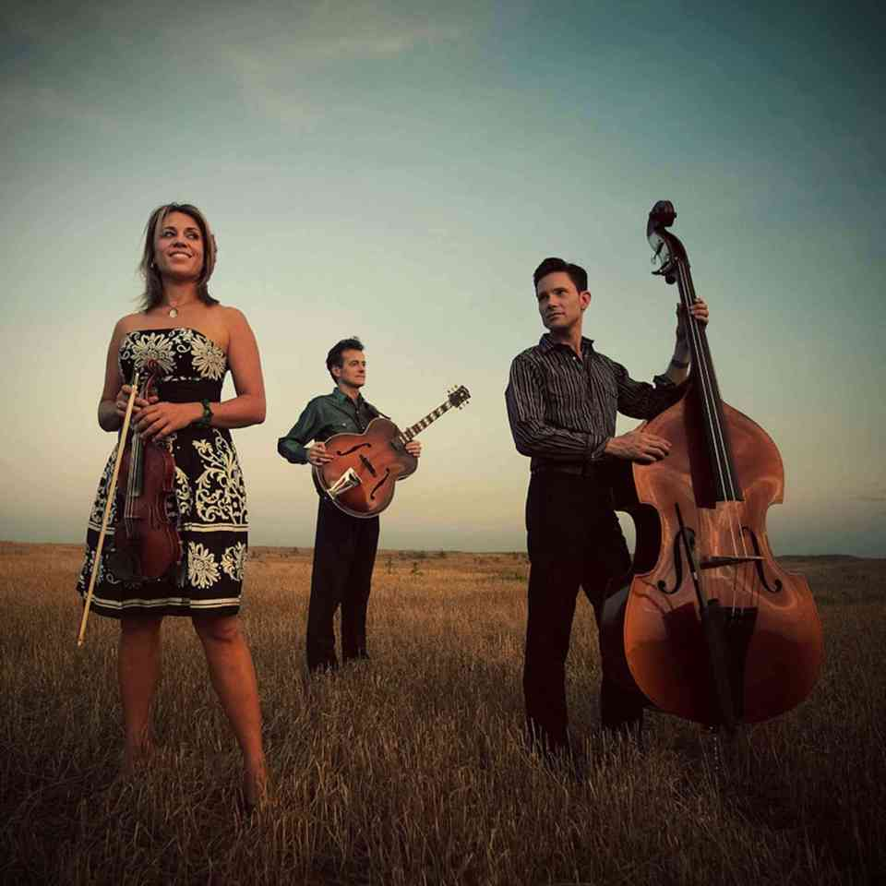
Western Swing Music Moving Forward
Course 19MM40
TCU Extended Education
Summer 2019

Slide 2
Western Swing Moving Forward
Current artists
Their history
Style
A ‘reimagining?’
Traditional approach?
Class discussion:
How do we preserve this music moving forward?
What should be the main goals and the focus?
What could Fort Worth do to claim, preserve and promote our city as the birthplace?

Slide 3
Asleep At The Wheel
1970-present
‘A Ride With Bob’ (2005)
An original musical based on the conversation Ray Benson “never had” with Bob Wills
Ends with a 30-minute AATW concert
www.asleepatthewheel.com

Slide 4
The Time Jumpers

Slide 5
The Time Jumpers
1998-present
Began as a “garage band” for fun!
Professional Nashville session musicians who sought Western Swing as a hobby/outlet
Often perform original music
Multiple Grammy nominations
Won Best American Roots Song for “Kid Sister” in 2017

Slide 6
The Time Jumpers
Collaborations with Vince Gill, Miranda Lambert, Reba McEntire, Asleep At The Wheel, Willie Nelson, etc.
You can catch them Monday nights in Nashville at 3rd & Lindsley @ 9 PM
www.facebook.com/thetimejumpers

Slide 7
Hot Club of Cowtown

Slide 8
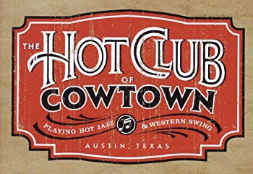
Hot Club of Cowtown
Elana James (vocals, violin), Whit Smith (vocals, guitar), Jake Erwin (vocals, bass)
From New England to San Diego to Austin, TX
Influences are very interesting…
Western Swing
Django Reinhardt/Gypsy Jazz
Rockabilly
Old fiddle tunes
Jazz ballads and swing
Dhrupad/Classical

Slide 9
Hot Club of Cowtown
Let’s talk about their sound….
Traditional or reimagined? ☺
Trio setting – but a “fat” sound!!
They sound like twice as many people. Seriously.
Original music + covers
Unique approach
Marketability
Youth, fresh perspective, but respect the tradition
www.hotclubofcowtown.com

Slide 10
Jason Roberts
Born in 1975
Achieved notoriety with Asleep At The Wheel
Grew up listening to Johnny Gimble
Old time fiddle
Learning “licks”
Loves to improvise jazz fiddle

Slide 11
Jason Roberts
Solo project as the Jason Roberts Band
And…currently leading the Bob Wills’ Texas Playboys band
Traditional or reimagined? ☺
Respect for tradition
Youth, energy
www.jasonrobertsband.com

Slide 12
Quebe Sisters Band

Slide 13
Quebe Sisters Band
From Burleson, TX
Studied Classical and old time fiddle
Blend fiddle music, western swing, jazz and swing, and country
Collaborations and performances with Marty Stuart, Ricky Skaggs, Asleep At The Wheel, Kacey Musgraves, Merle Haggard, Willie Nelson, Riders In The Sky, and others

Slide 14
Quebe Sisters Band
Their sound…
Traditional or reimagined? ☺
Andrews Sisters meets Bob Wills meets The Mills Brothers meets Gene Autry meets Ella Fitzgerald!!
Excellent musicianship and arrangements
Youth and energy
www.quebesisters.com

Slide 15
Highlights: Emily Gimble, Katie Shore
Emily Gimble – Austin, TX
Katie Shore – Austin, TX

Slide 16
Highlights: Emily Gimble / Katie Shore

Slide 17
Highlights: Emily Gimble / Katie Shore
Emily Gimble – Austin, TX
Katie Shore – Austin, TX
From a musical family!
Dick Gimble, Johnny Gimble
“Western swing royalty”
Accomplished vocalist, keyboardist, and composer
Former member of Asleep At The Wheel
Several collaborations
Warren Hood Band, Whit Smith, Katie Shore, Merle Haggard
www.emilygimble.com
From Fort Worth, TX
Inspired to play fiddle by her grandfather
Current member of Asleep At The Wheel
Collaborations include Willie Nelson, George Strait, Ivy Divey (with Emily Gimble and Albanie Falletta)
www.katieshoremusic.com

Slide 18
Shoot Low Sheriff

Slide 19
Shoot Low Sheriff
Dallas/Fort Worth-based
Often performing original music
Traditional or reimagined?
Respect for the classic sound
Songwriting
Horns/piano
www.shootlowsheriff.com

Slide 20
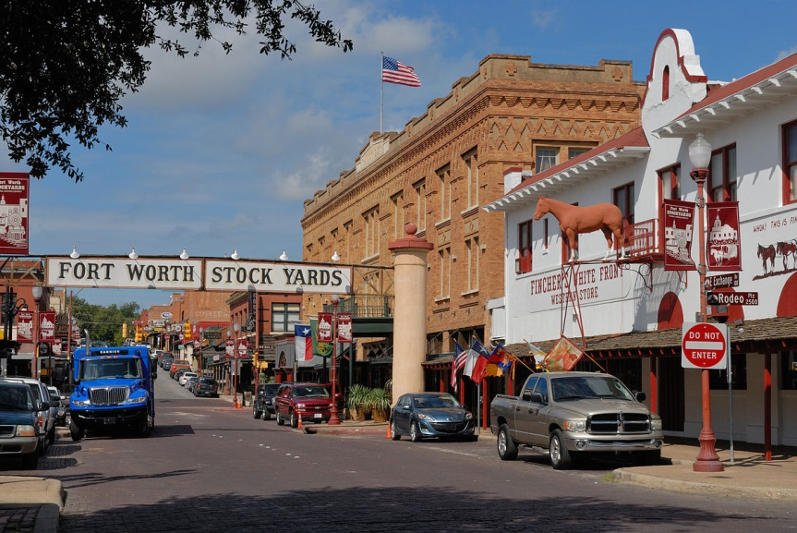
Western Swing Moving Forward
Hey y’all, remember I mentioned a class discussion? Yay!
Let’s ponder:
How do we preserve this music moving forward?
What should be the main goals and the focus?
What could Fort Worth do to claim, preserve and promote our city as the birthplace?
Discuss!

